Slide 1



Chapter 2
Financial and behavioral impacts of
customer service
vice
Introduction to customer service
© Hudson & Hudson. Customer Service for Hospitality & Tourism 3rd edn

Slide 2
Topics covered
  Relative importance of the service economy
  Impact of service quality on market share, price and profits
  Behavioral consequences of customer service
  Service profit chain
  Offensive and defensive marketing effects of service
  The financial implications of poor customer service

Slide 3

‘At Your Service’ Spotlight:
Scott Dunn Travel
‘If you’re part of the DNA of the company, you understand the importance of the guest,’ Andrew Dunn.
British luxury travel company established a benchmark for Alpine chalet holidays
70% repeat business through loyalty and referral
Differentiated on opulence and personal, high quality service
  Unexpected acts of kindness (U.A.K.s)
Undersells, over-delivers

Slide 4
Service quality
….customers’ perceptions of the service component of a product, and these perceptions are said to be based on five dimensions: reliability, assurance, empathy, responsiveness, and tangibles
Evaluation of purchase, determine satisfaction and likelihood of repurchase
Key factor in differentiating service products and building competitive advantage
Impacts profits and other financial outcomes of the organization
“Quality is far and away the chief factor in competitiveness” (Sharp, 2009: 91).
Since the COVID-19 pandemic, customer expectations have been higher than ever

Slide 5
Relative importance of the service economy
Shift from manufacturing to a focus on customer service
  Quality service increasingly critical to success
Services sector employment
  45 % of the world’s total labor force
  7 out of 10 people in global service industries
Share in total economic activity increasing over time
  Western countries, accounts for over ¾ of GDP
Rising trend expected to continue
  Reflects higher consumer and business demand,
  Outsourcing of service-related activities
  Information technology

Slide 6
The impact of service quality on market share, price and profits
Service quality is crucial for:
  Differentiating service products
  Winning and retaining customers
  Building a competitive advantage
An outgrowth of service quality is customer satisfaction which is:
  Key to long-term profitability
  But ‘satisfying’ customers not enough
  Need to delight customers to ensure long-term loyalty

Slide 7
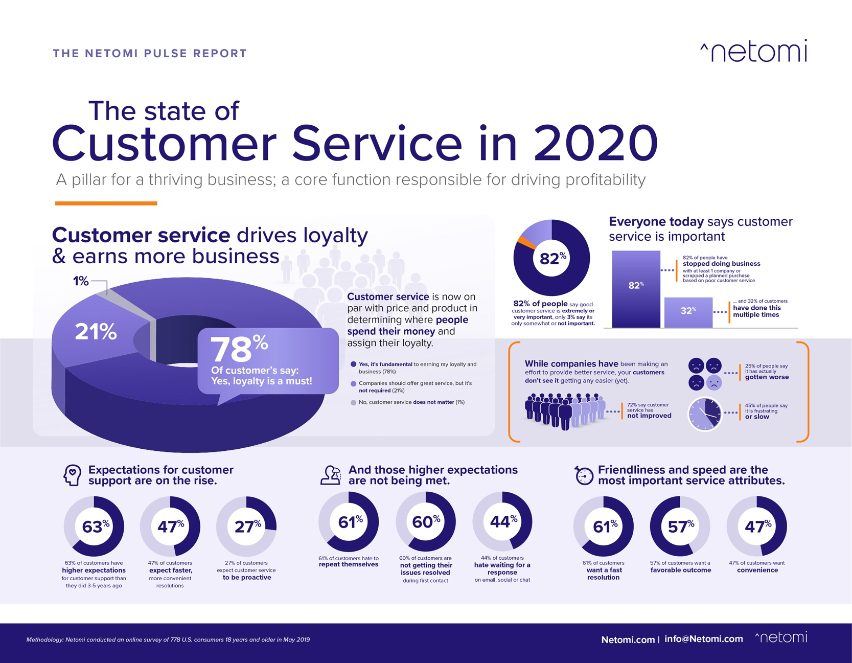

Slide 8
Market share
Service quality key factor to:
  Differentiate service products
  Win and retain customers
  Build a competitive advantage
Customer satisfaction is:
  key to long-term profitability
  But ‘satisfying’ customers not enough
  Need to delight customers to ensure long-term loyalty

Slide 9
Satisfaction measure

Slide 10
High service quality means higher prices, profits and market share
  Premium prices
  ~8 % higher price than competitors (Gale, 1992)
  Retaining 5 % of customers
  Increase profits by 25% - 85 %
    Higher-than-normal market share growth

Slide 11
Value of great service

Slide 12
Snapshot:
Jonathan Tisch, Loews Hotels & Resorts
‘The Power of We’ - success cannot be achieved individually
Professional philosophy
  Building relationships with colleagues
  Empowering employees
  Collaborating with competitors
Customer outreach
  Beyond advertising campaigns
  “Buzz” and word-of-mouth marketing
  Creates customer experiences
Good Neighbor Policy
  Comprehensive outreach program
  Links business with communities
  Advocates social responsibility
  “At the heart of hospitality is the notion of making people feel comfortable, making people feel welcome and keeping them safe and secure”

Slide 13
The behavioral consequences of customer service
Positive behavioral intention indicators
  Saying positive things
  Recommending company or service
  Paying a premium
  Demonstrating loyalty
Negative behavioral intention
  Complaining
  Spending less money
  Signaling poised to leave the company

Slide 14
Behavioral and financial consequences of service quality

Slide 15
The Apostle Model

Slide 16
The service profit chain
Employee satisfaction, loyalty
  Internal service quality
  Employee productivity
Customer satisfaction, loyalty
  Value of services provided to the customer
  Customer retention
Lifetime value of a customer
  Financial value of long-term relationships
  Potential lifetime revenue
    Average lifespan
    Sales of additional products and services
    Referrals

Slide 17
The service profit chain

Slide 18


The lifetime value of a family to Disney is over $50,000
For the ski industry, the lifetime value of a skier/boarder is $52,024

Slide 19
Offensive and defensive marketing
Offensive marketing
  Attract more, better customers
  Improve reputation
    Higher market share
    Price premiums
Defensive marketing
Retain existing customers
Longtime customer more profitable
Lower costs
Attracting a new customer five times more costly

Slide 20
Offensive and defensive marketing effects of service

Slide 21
Financial implications of poor customer service
Consumer spending trends correspond with customer satisfaction
  Unhappy customers spend less
Frustrated customers may share unfavorable opinions
  Social media, customer service terrorists
Business spending to replace customers
  81 % of American, refuse to do business after poor service

Slide 22
Resolving customer complaints
Associated cost
  52 % expect compensation, even if the problem is resolved
  70 % seek apology, reimbursement
Consumers more forgiving if a company has earned trust over time
  9/10 consumers willing to give a company a second chance
  If they have experienced great customer service in the past
Reducing customer defections by 5 % can double profits

Slide 23
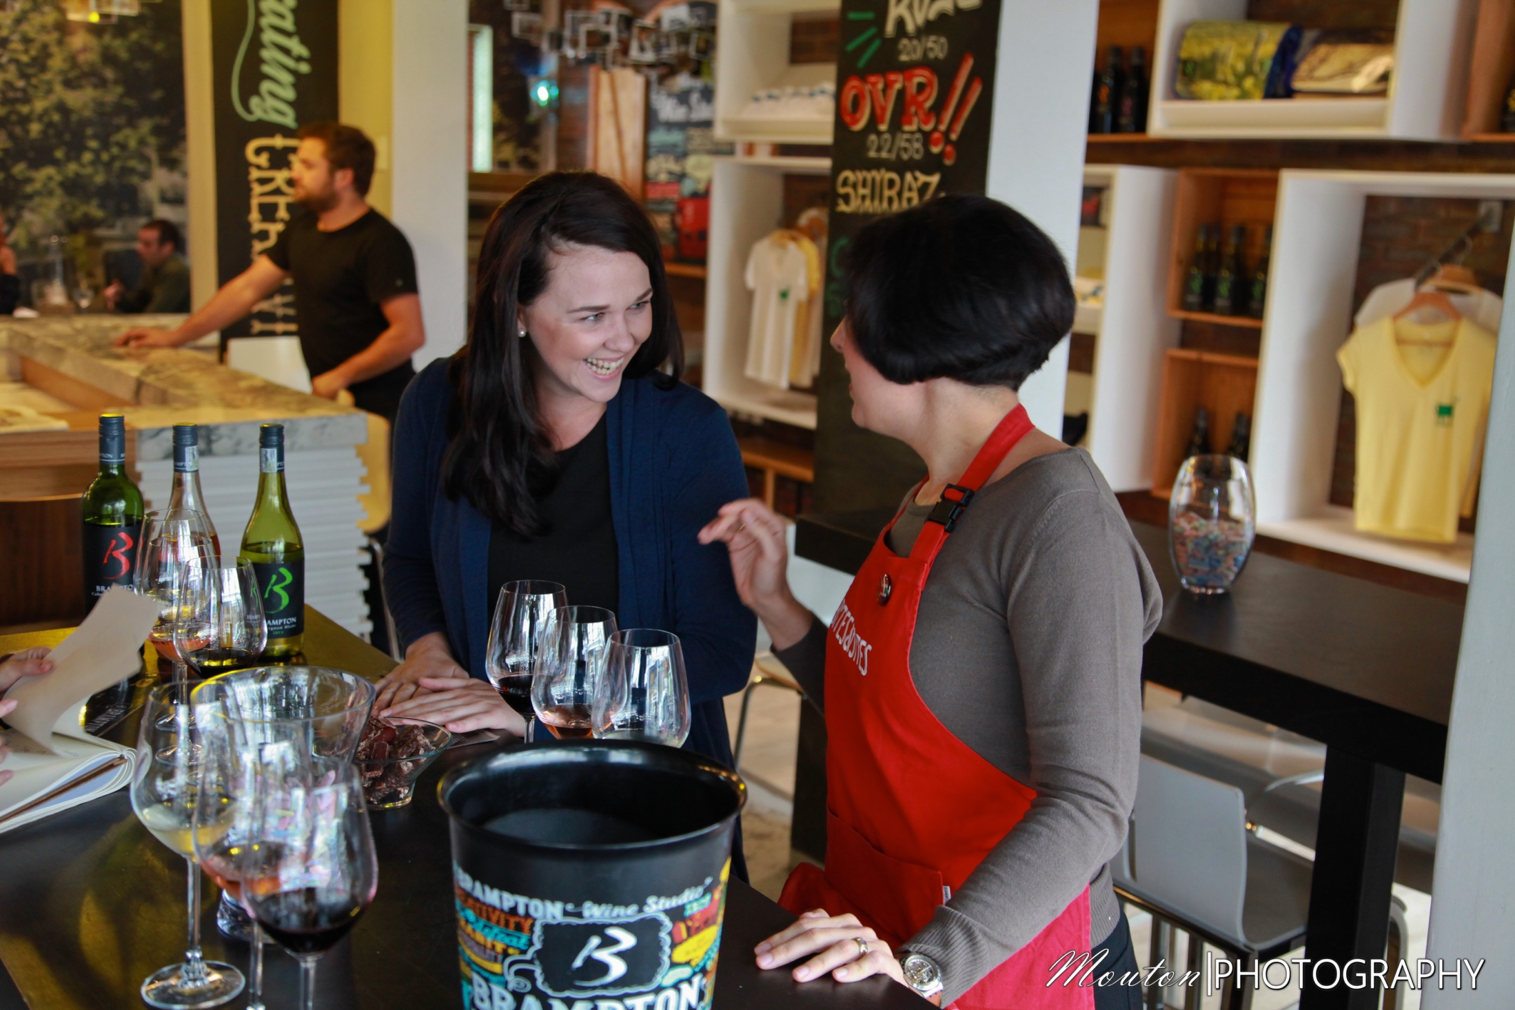
Case Study:
Profiting from culinary tourism
The wine tourism sector contributes over a billion dollars annually to the South African economy.
The Stellenbosch Local Economic Development (LED) strategy unites economic stakeholders to cooperate in improving the economic future of the area.
‘Foodies on Foot’ tours are run by Bites and Sites Food Tours and combine historical and contemporary culture with cuisine.
Use an integrated communications strategy to attract customers

